Slide 1

Conflict detection of network security policies across the Kubernetes stack with incremental approach
Jasper Goris, Master toegepaste informatica
Promotors: Wouter Joosen , Eddy Truyen, Tobias Mühlberg
Mentor: Gerald Budigiri

Slide 2
Overview
Kubernetes: what, how and why
The 4 C’s of Kubernetes security
Conflict example
State of the art (Kano)
Algorithm
Evaluation (Experiment 1)
Final work

Slide 3
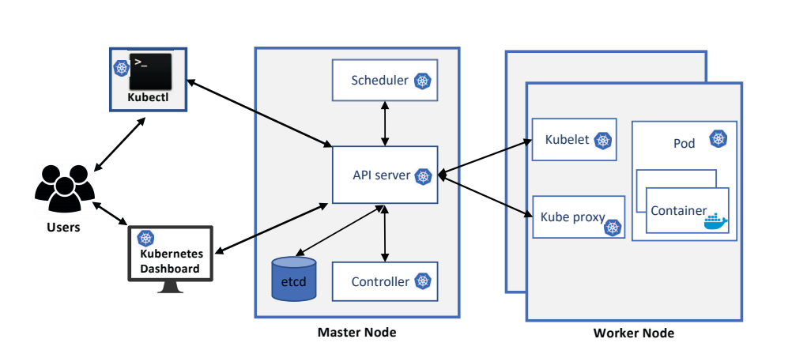
Kubernetes: Why and how?
Cloud native computing
Increasing scale = management issues
=> Kubernetes!
Container orchestration tool
Scaling, resource sharing, load-balancing, …
A brief overview of Kubernetes [1]
Notes:
Installation = cluster
Cluster -> nodes -> pods -> containers (Docker containers)

Slide 4
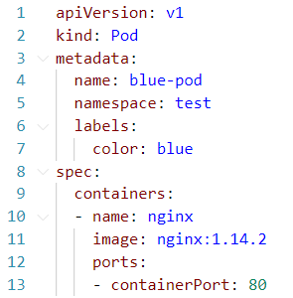
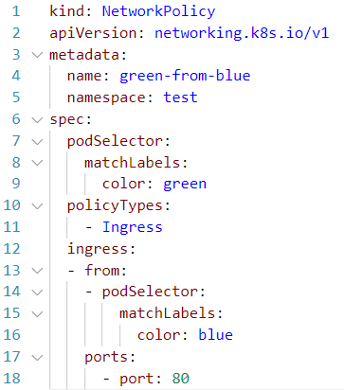
Kubernetes network policies (NPs)
Label = key-value combination
Pods get assigned labels
Network policies:
podSelector: To which labels the NP applies
PolicyTypes: Ingress or Egress
from/to: from/to which labels communication is allowed

Slide 5
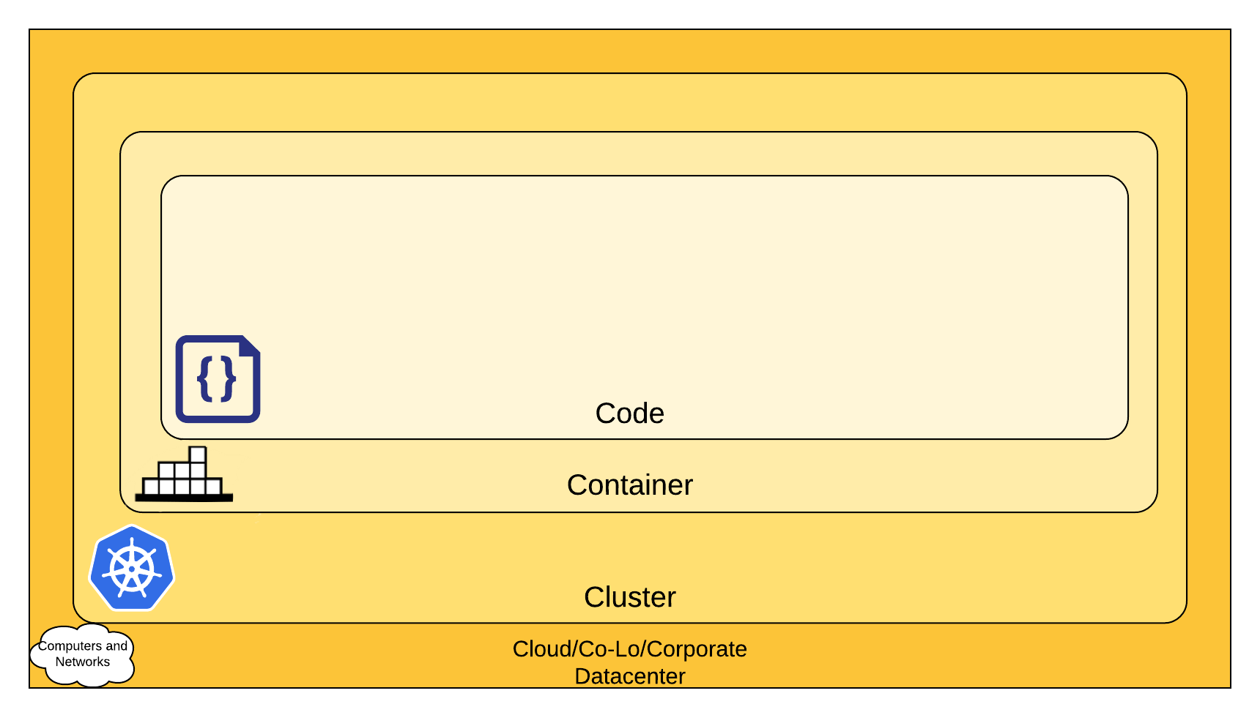
The 4 C’s of Kubernetes security
Code layer: Defensive programming
Container layer: OCI guidelines [3]
Cluster layer: Application manager deploys containers and pods
Policies between containers, e.g. K8s network policies
Cloud layer: Cloud manager Manages VMs
Policies between VMs, e.g. Openstack Security Group rules
‘Multiple truths’ problem
4 C’s of Kubernetes [2]

Slide 6
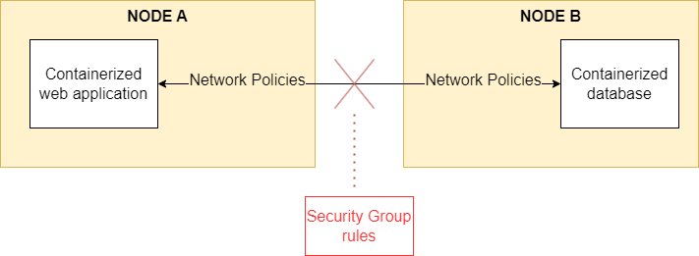
Conflict example
Web and database application
K8s network policies allow communication
Deployed on separate nodes
Openstack security group rules do not allow communication
=> Broken web application

Slide 7
State-of-Art
Grashopper: Single truth in Network Polices to enforce compliant security groups [4]
Kano: conflict detection between K8s network policies [5]
NFVGuard: multi-level security verification, but in NFV stack with FOL [6]
TenantGuard: general network isolation within a single layer [7]
Microsegmentation tools: Least privilege and zero trust to create separate groups and minimise lateral movement in the cluster. E.g. PrismaCloud [8], Cisco ACI [9] and VMWare NSX [10]
Notes:
Grashopper: single truth instead of multiple
Kano: Only cluster layer
NFVGuard: in NFV and FOL
TenantGuard: Single layer, no checks between layers
Microsegmentation tools: Only cluster layer

Slide 8
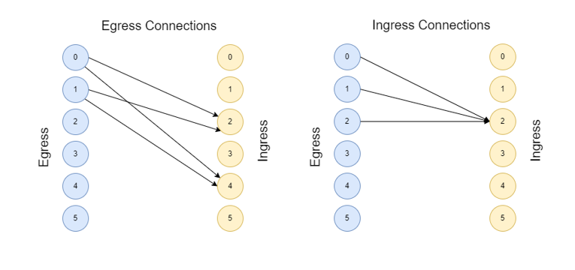
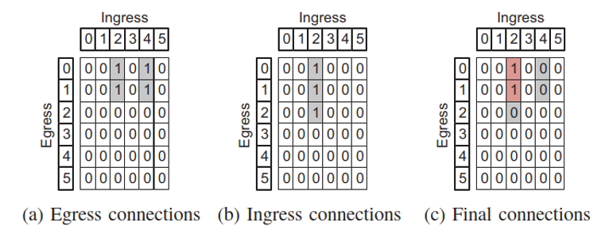
Kano 1/2
2 bipartite graphs: egress and ingress
Vertices: Containers
Edges: Policies
Transform to matrices
Create intersection: Reachability matrix
Prefiltration algorithm for faster generation
Container network reachability matrix model [5]

Slide 9
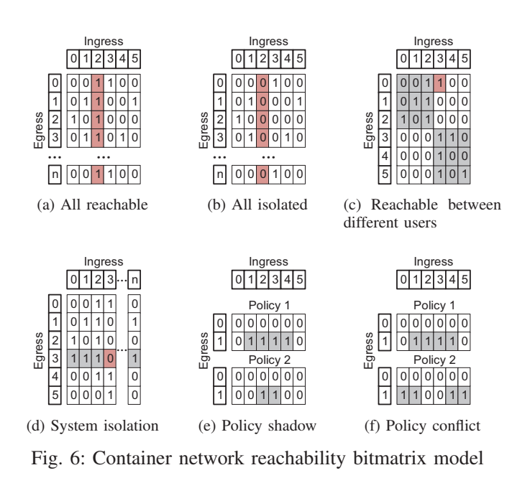
Kano 2/2
Different situations to be read:
All reachable
All isolated
Reachable between users
System isolation
Policy shadow
Policy conflict
Limited to Container level of 4 C’s
Container network reachability bitmatrix model [5]

Slide 10
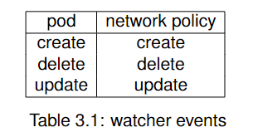
My thesis
Consistency between security policies through layers
Incremental approach: event based updating of reachabilitymatrix by storing cluster state
Compare updated reachabilitymatrix against previous cluster state, find changes and check for conflicts

Slide 11
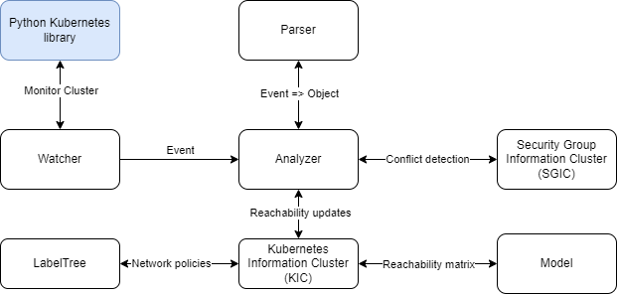
The algorithm
Watcher: Leverage Python K8s library to capture events
Analyzer: Orchestrate event handling
KIC: Store cluster state, reachabilitymatrix updating
SGIC: Generate randomised security group (rules) and conflict detection
Model: custom data structures
LabelTree: Tree like data structure to store network policies

Slide 12
Evaluation:
What is the difference in time cost between an incremental update of the Kanomatrix compared to newly generating the Kano matrix for every event and how does this difference scale with pod/policy numbers
What is the difference in space cost between an incremental update of the Kano matrix compared to newly generating the Kano matrix for every event and how does this difference scale with pod/policy numbers
What is the relationship between pod/policy numbers and the time cost of conflict detection?
What is the relationship between pod/policy numbers and the space cost of conflict detection?
Experiment 1
Experiment 2

Slide 13
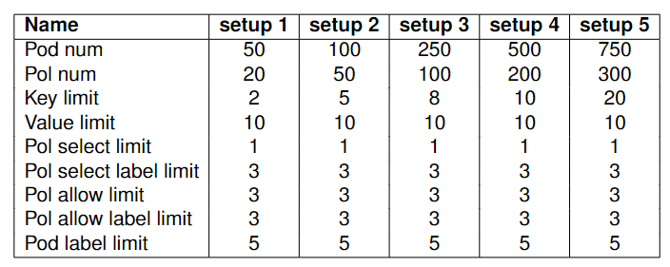
Experiment 1
4 events
5 setups
100 runs
4*5*100 = 2000 data points
Time (ms)
Memory at start (bytes)
Peak memory (bytes)
Difference (peak – start)

Slide 14
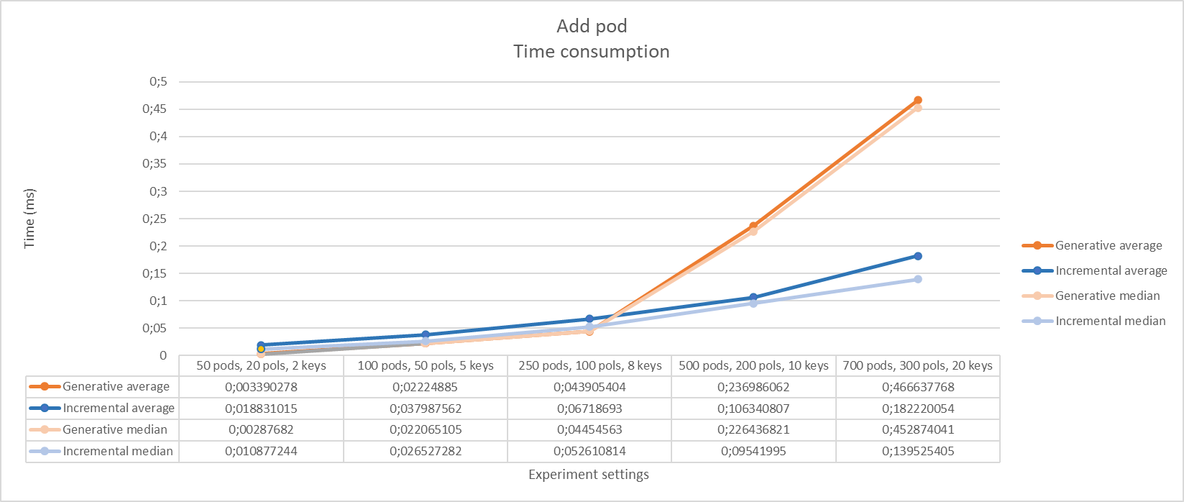
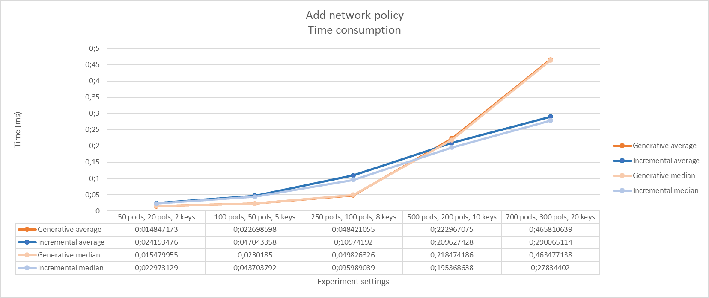
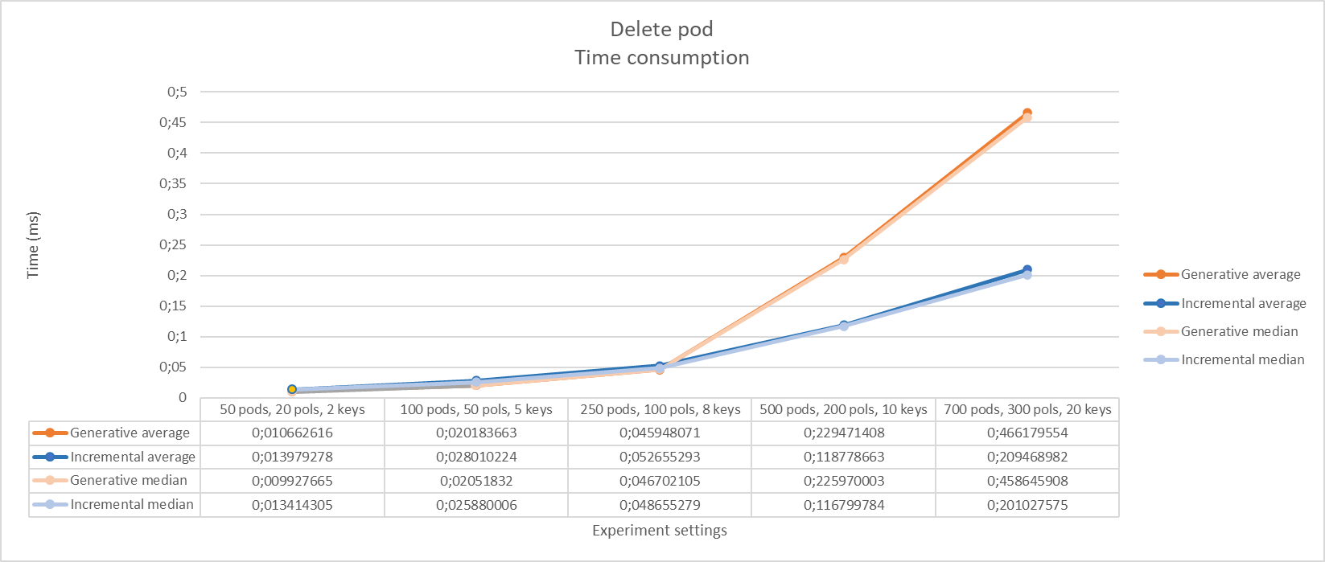
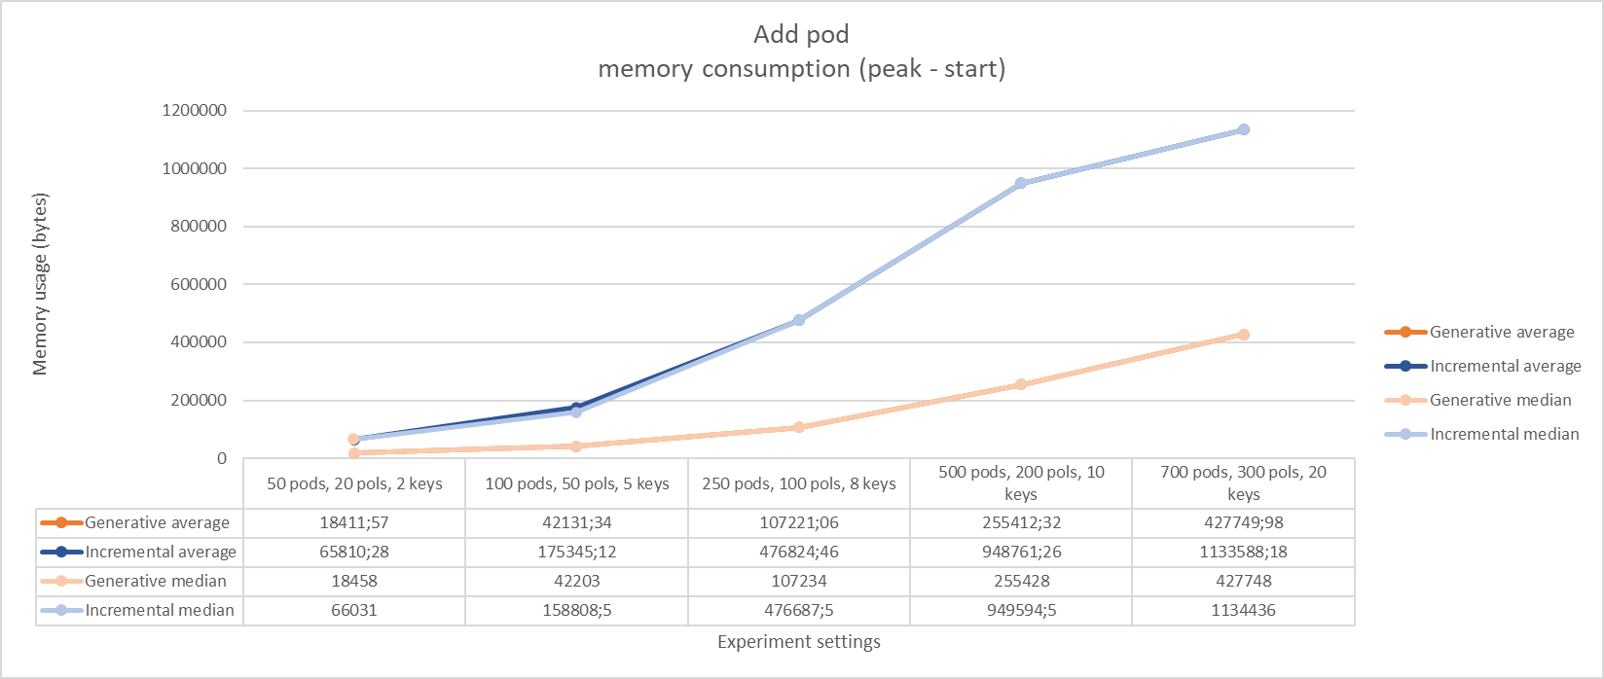
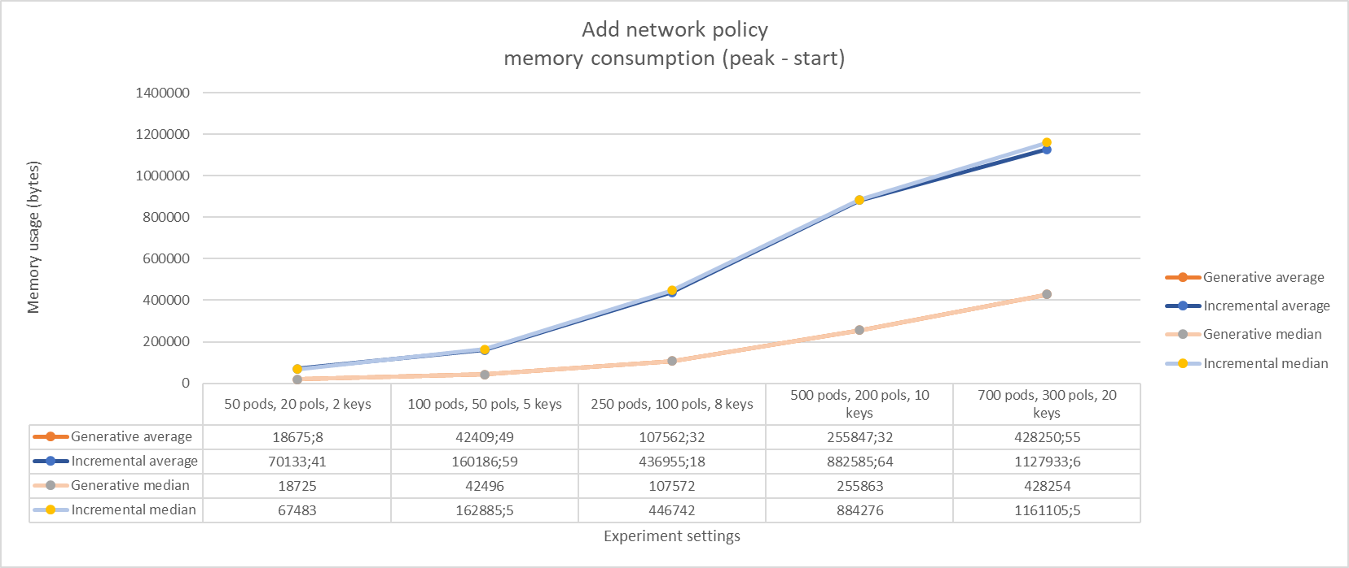
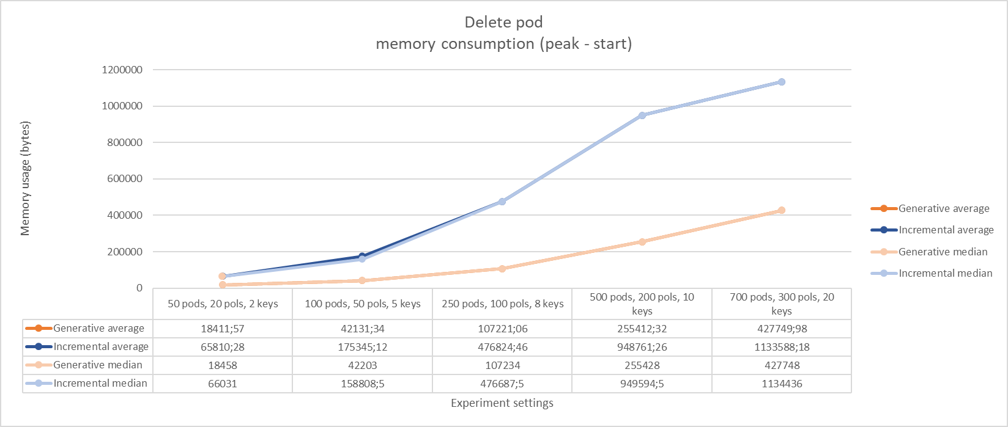
Results (1/4) TODO

Slide 15
Results (2/4)

Slide 16
Results (3/4)

Slide 17
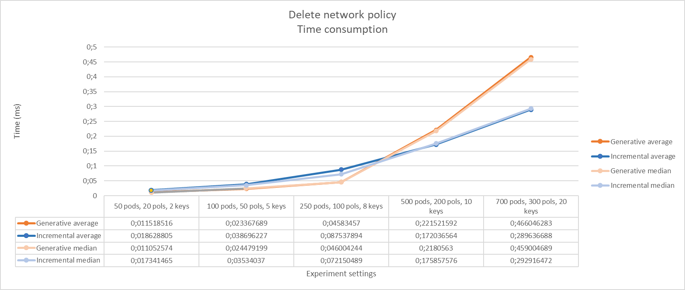
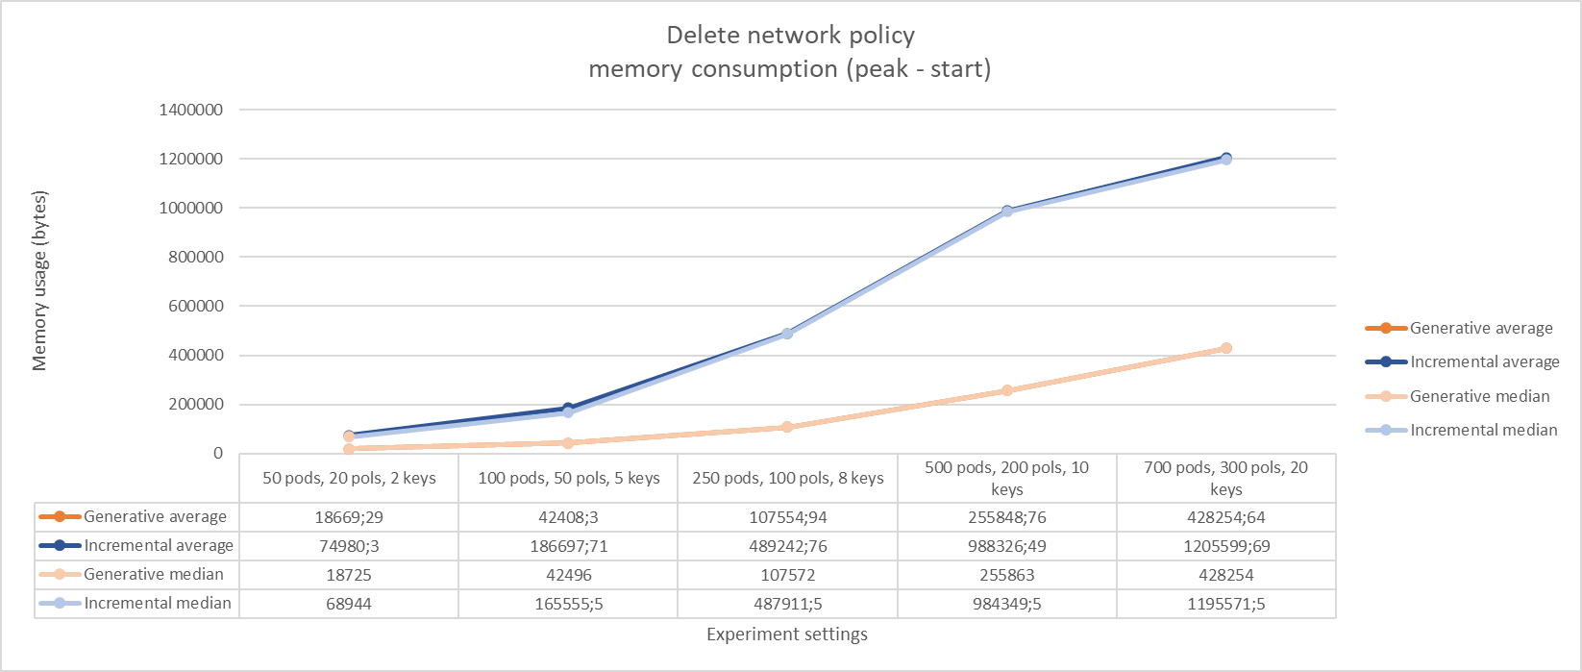
Results (4/4)

Slide 18
Final work:
Experiment 2 (ongoing)
Evaluation chapter (half finished)
Conclusion chapter
Abstract, Summary etc

Slide 19
Sources
[1] M. S. Islam Shamim, F. Ahamed Bhuiyan and A. Rahman, "XI Commandments of Kubernetes Security: A Systematization of Knowledge Related to Kubernetes Security Practices," 2020 IEEE Secure Development (SecDev), 2020, pp. 58-64, doi: 10.1109/SecDev45635.2020.00025.
[2] Kubernetes. “Overview of Cloud Native Security”. Kubernetes. https://kubernetes.io/docs/concepts/security/overview/ (accessed December 5, 2022)
[3] “Open Container Initiative Charter v1.3.” [Online]. Available: https://github.com/opencontainers/tob/blob/main/CHARTER.md
[4] G. Budigiri, C. Baumann, E. Truyen, J. T. Muhlberg, and W. Joosen, “Zero-Cost In-Depth Enforcement of Network Policies for Low-Latency Cloud-Native Systems,” IEEE International Conference on Cloud Computing, CLOUD, vol. 2023-July, pp. 249–261, 2023
[5] Y. Li, C. Jia, X. Hu, and J. Li, “Kano: Efficient container network policy verification,” in Proceedings - Symposium on the High Performance Interconnects, Hot Interconnects, vol. 2020-Augus. Institute of Electrical and Electronics Engineers Inc., aug 2020, pp. 63–70.
[6] A. Oqaily, L. T. Sudershan, Y. Jarraya, S. Majumdar, M. Zhang, M. Pourzandi, L. Wang, and M. Debbabi, “NFVGuard: Verifying the Security of Multilevel Network Functions Virtualization (NFV) Stack,” Proceedings of the International Conference on Cloud Computing Technology and Science, CloudCom, vol. 2020-Decem, pp. 33–40, dec 2020.
[7] Y. Wang, T. Madi, S. Majumdar, Y. Jarraya, A. Alimohammadifar, M. Pourzandi, L. Wang, and M. Debbabi, “TenantGuard: Scalable Runtime Verification of Cloud-Wide VM-Level Network Isolation,” may 2017
[8] “Prisma Cloud.” [Online]. Available: https://docs.prismacloud.io/en/classic/cspm-admin-guide/get-started-with-prisma-cloud/prisma-cloud
[9] “Cisco ACI and Kubernetes Integration New and Changed Information 2.” [Online]. Available: https://www.cisco.com/c/dam/en/us/td/docs/Website/datacenter/aci/virtualization/matrix/virtmatrix.htmlciscoaci
[10] “NSX Container Plugin for Kubernetes and Tanzu Application Service-Installation and Administration Guide NSX Container Plugin for Kubernetes and TanzuApplication Service-Installation and Administration Guide VMware, Inc. 2,” 2017.[Online]. Available: https://docs.vmware.com/www.vmware.com

